Slide 1
Cascading Style Sheet (CSS)
CSS describe the appearance, layout, and presentation of information on a web page (as opposed to HTML, which describes the content of the page)
CSS also describe how information is to be displayed, not what is being displayed
CSS can be embedded in HTML document or placed into separate file called .css

Slide 2
More on CSS
Styles are normally stored in Style Sheets
Styles were added to HTML 4.0 and above to solve a problem
External Style Sheets can save you a lot of work

Slide 3
Benefits of CSS
CSS is a breakthrough in Web design because it allows developers to control the style and layout of multiple Web pages all at once.
As a Web developer you can define a style for each HTML element and apply it to as many Web pages as you want.
To make a global change, simply change the style, and all elements in the Web are updated automatically.

Slide 4
Types of CSS Application
1. External style sheet
2. Internal style sheet (inside the <head> tag)
3. Inline style (inside an HTML element) or embedded
So, an inline style (inside an HTML element) has
the highest priority, which means that it will
override a style declared inside the <head> tag,
in an external style sheet, or in a browser (a
default value).

Slide 5
CSS Syntax
The CSS syntax is made up of three parts:
a selector,
a property and
a value:
selector {property: value}
The selector is normally the HTML element/tag you
wish to define, the property is the attribute you
wish to change, and each property can take a value.
The property and value are separated by a colon,
And surrounded by curly braces:
For example,
Man{Height: tall} or body {color: black}

Slide 6
CSS Syntax Cont’d
Note: If the value is multiple words, put quotes around the value:
p {font-family: "sans serif"}
Note: If you wish to specify more than one property, you must separate each property with a semicolon. The example below shows how to define a center aligned paragraph, with a red text color:
p {text-align:center; color:red}
<head> <link rel="stylesheet" type="text/css" href="mystyle.css" /> </head>
To make the style definitions more readable, you can describe one property on each line, like this:
p { text-align: center; color: black; font-family: arial }

Slide 7
Quiz(5 mks)
1. Create html file of your profile, which include your name, course and others with a title. Use h1,h2,h3 for the headings and others as specified above. Insert an image of your choice with this dimensions: width 30%, height 30%.
2. Let the css file be named personal.css
Use h1{color:green}
h1{font-family: Algerian}
H2,h3,h4{color:orange}

Slide 8
Grouping
You can group selectors. Separate each selector with a comma. In the example below we have grouped all the header elements. All header elements will be displayed in green text color:
h1,h2,h3,h4,h5,h6 { color: green }
The class Selector
With the class selector you can define different styles for the
same type of HTML element.
Say that you would like to have two types of paragraphs in your
document: one right-aligned paragraph, and one center-aligned
paragraph. Here is how you can do it with styles:
p.right {text-align: right} p.center {text-align: center}
You have to use the class attribute in your HTML document:
<p class="right"> This paragraph will be right-aligned.
</p> <p class="center"> This paragraph will be center-aligned.
</p>

Slide 9
Rules for forming a Class
Do NOT start a class name with a number! It will not work in Mozilla/Firefox.
Add Styles to Elements with Particular Attributes

Slide 10
How to Insert a Style Sheet
External Style Sheet
An external style sheet is ideal when the style is applied to many pages.
Each page must link to the style sheet using the <link> tag.
The <link> tag goes inside the head section:
for example, <head> <link rel="stylesheet" type="text/css" href="mystyle.css" /> </head>
An example of a style sheet file is shown below:
hr {color: sienna}
p {margin-left: 20px}
body {background-image: url("images/back40.gif")}
Do NOT leave spaces between the property value and the units! If you use "margin-left: 20 px" instead of "margin-left: 20px" it will only work properly in IE6 but it will not work in Mozilla/Firefox or Netscape.

Slide 11
Internal Style Sheet
An internal style sheet should be used when a single document has a unique style. You define internal styles in the head section by using the <style> tag, like this:
<head> <style type="text/css">
h1 {color: sienna}
p {margin-left: 20px}
body {background-image:
url("images/back40.gif")} </style> </head>

Slide 12
Inline Styles or Embedded
An inline style loses many of the advantages of style sheets by mixing content with presentation. Use this method sparingly when a style is to be applied to a single occurrence of an element.
The example shows how to change the color and the left margin of a paragraph:
<p style="color: sienna; margin-left: 20px"> This is a paragraph </p>

Slide 13
CSS Properties for Colours
p {color: red; background-color: yellow;}
This paragraph uses the style above.
color: color of the element's text
background-color: color that will appear behind the element

Slide 14
Specifying Colours
p { color: red; }
h2 { color: rgb(128, 0, 196); }
h4 { color: #FF8800; }
This paragraph uses the first style above.
This heading uses the second style above.
This heading uses the third style above

Slide 15
color names: aqua, black, blue, fuchsia, gray, green,
lime,maroon,navy, Olive, purple,red,silver, teal, white,yellow
RGB codes: red, green, and blue values from 0
(none) to 255 (full)
hex codes: RGB values in base-16 from 00 (0, none)
to FF (255, full)

Slide 16
CSS Properties for fonts
font-family: which font will be used
font-size: how large the letters will
be drawn
font-style: used to enable/disable
italic style
font-weight: used to enable/disable
bold style complete list of
font properties

Slide 17
Font Family
font-family { font-family: "Georgia“;}
h2 { font-family: "Arial Narrow“;}
This paragraph uses the first style above.
This heading uses the second style above

Slide 18
Font-size
p { font-size: 14pt;}
This paragraph uses the style above.
vague font sizes: xx-small, x-small, small, medium, large, x-large, xx-large
relative font sizes: smaller, larger
percentage font sizes, e.g.: 90%, 120%
units: pixels (px) vs. point (pt) vs. m-size (em)
16px,16pt,1.16em
px: specifies a number of pixels on the screen
(absolute)

Slide 19
Font Size Cont’d
pt: specifies number of point,
where a point is 1/72 of an inch
onscreen
em: specifies the number of m-
widths, where 1 em is equal to the
font's current size

Slide 20
Font-Weight & Font-Style
p {font-weight: bold; font-style: italic;}
Body styles
body { font-size: 16px; }
to apply a style to the entire body of
your page, write a select for the
body element saves you from manually
applying a style to each element.

Slide 21
Quiz
The entire page should have a pink background and use 16 point font
The main heading should use Comic Sans MS
font
The lists should appear in a Lucida Console font
List numbers should have yellow background; list items should have green background
Link text should be purple quote, text should be italicized

Slide 22
Strong & em not i and b
Strong and em describe attributes of the
content (it is something Important in the
document that you want to emphasize) b and
I describe formatting and presentation ("I
want this to be bold.")
strong { font-weight: normal; color: red; }
em { font-style: normal; background-color: #DDDDDD;}

Slide 23
Text-align & Text decoration
blockquote { text-align: justify;}
h2 { text-align: center;}
text-decoration
p { text-decoration: underline;}
Overline, line-through,blink
effects can be combined:
text-decoration: overline underline;

Slide 24
CSS properties for dimensions
p { width: 400px;background-color: yellow; }
h2 { width: 50%;background-color: aqua; }

Slide 25
CSS comments:
CSS comment /*…*/
/* This is a comment.
It can span many lines in the CSS file. */

Slide 26
Grouping styles
p,h1,h2 { color: blue; }
h2 { background-color: yellow; }

Slide 27
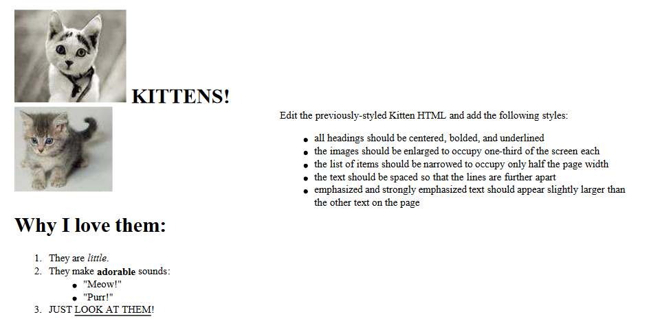
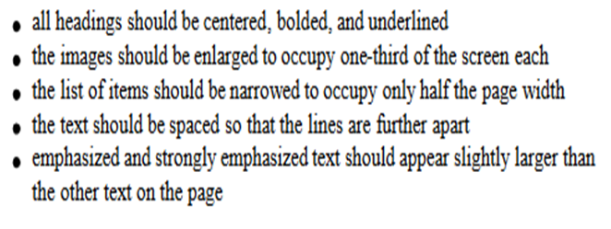
Practice Question

Slide 28
Background Properties
Background Image
body {background-image: url("draft.jpg");}
Background repeat
body {background-image: url("draft.jpg");
background-repeat: repeat-x;
}

Slide 29
Background-position
body {background-image: url("draft.jpg");
background-repeat: no-repeat;
background-position: 370px 20px;
}
It occupies 2 lines value consists of two tokens, each of which an be
Top, Left, right, bottom, center, a percentage, or a length
value in px, pt, etc.
value can be negative to shift left/up by a
given amount

Slide 30
Partial Image
.partialimage1, .partialimage2 {
background-image: url(“citydress.jpg");
background-repeat: no-repeat;
width: 70px; height: 200px;
}
.partialimage1 { background-position: 0px 0px;}
.partialimage2 { background-position: -115px 0px;}

Slide 31
Examples

Slide 32
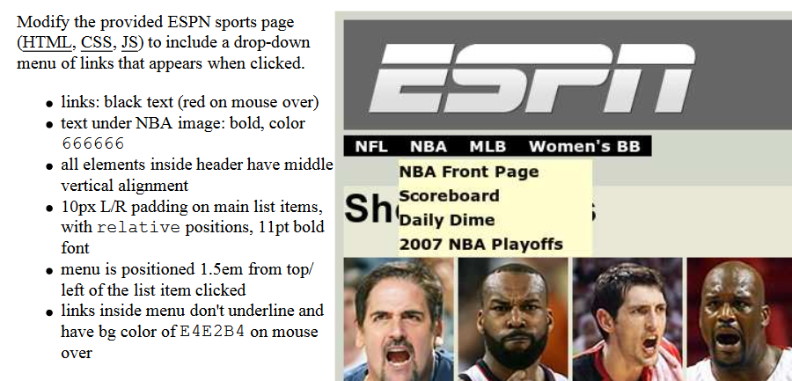
Practical Exercise

